Slide 1

Prognostication of Chronic Pancreatitis
using CT derived Radiomic Features
DongJae Seo

Slide 2
Contents
1
Introduction
2
Dataset | Preprocessing
3
Model Used
4
Outcomes
5
Summary

Slide 3
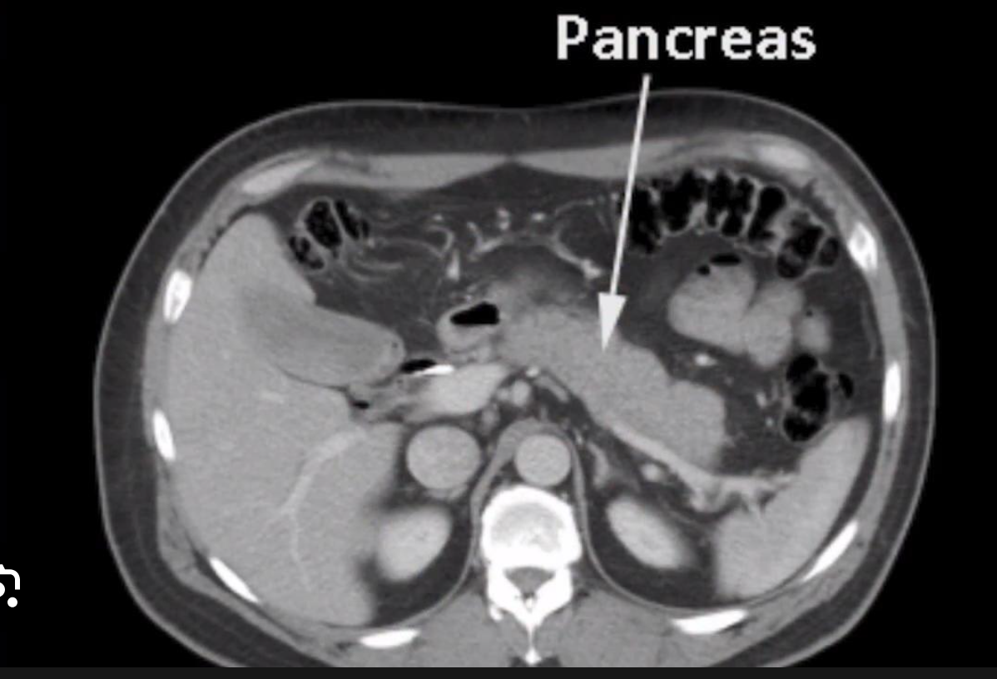
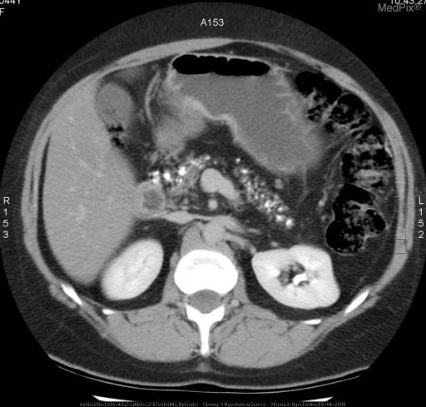
Introduction
Chronic Pancreatitis
Normal
Consequences of Chronic Pancreatitis on Pancreas
Calcification within Pancreas Tissue
Digestive Enzyme Production Reduction
Hormone Production Reduction – Insulin Production
Pain and Complication
Chronic
Pancreatitis

Slide 4
Introduction
Since Chronic Pancreatitis deeply affects pancreas functionalities,
early detection is crucial for
Preventing disease progression
Preserving Pancreas Function
Pain Management and preventing complications
Objective:
To aid outcome prediction of chronic pancreatitis from CT scans using segmentation
to improve patient outcomes through timely intervention

Slide 5
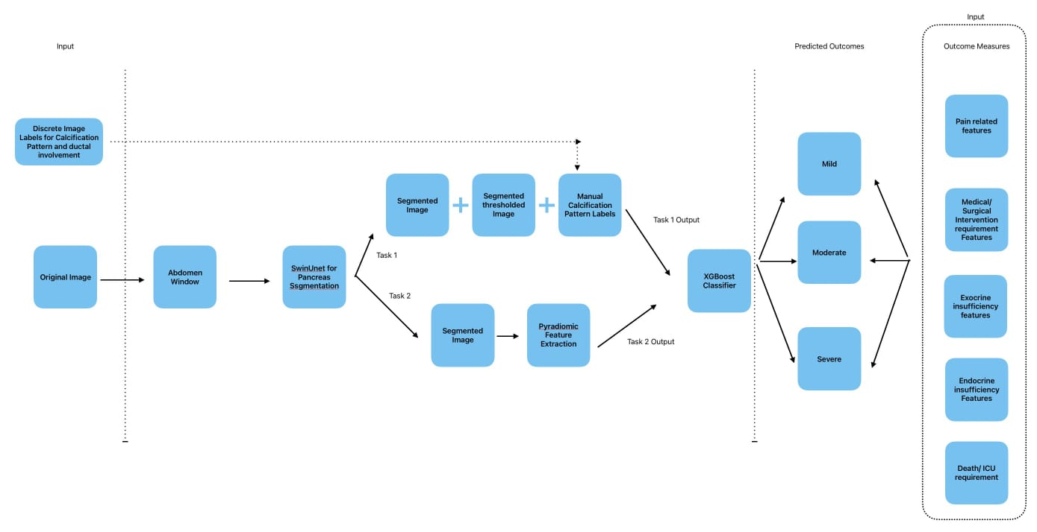
Introduction

Slide 6
Introduction
Calcification image
Segmentation image

Slide 7
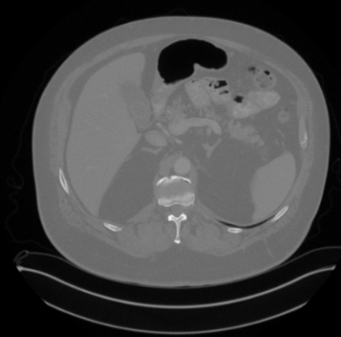
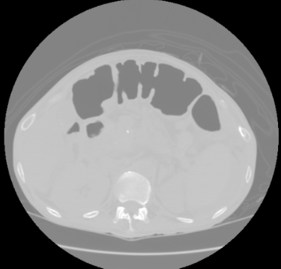
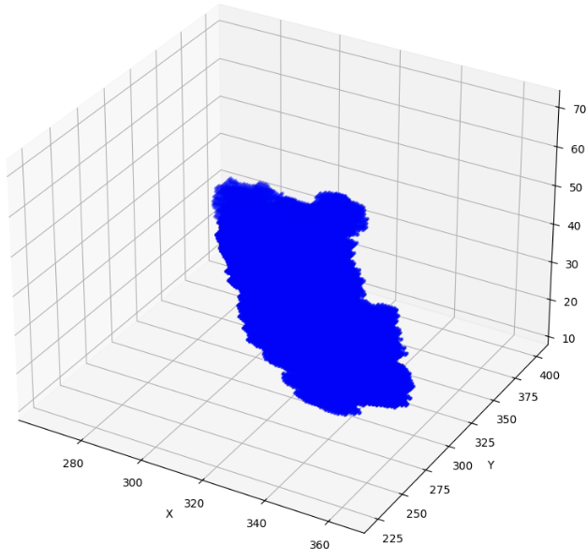
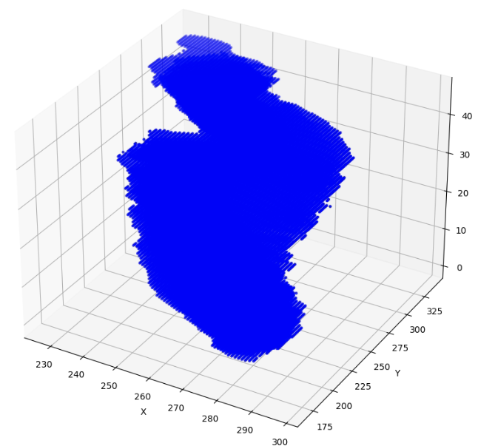
Data - CT82 | Chronic Pancreatitis Labels
Original Dataset Acquired (512x512)
CT-82
Chronic Pancreatitis
82 labeled
14 labeled
50 unlabeled

Slide 8
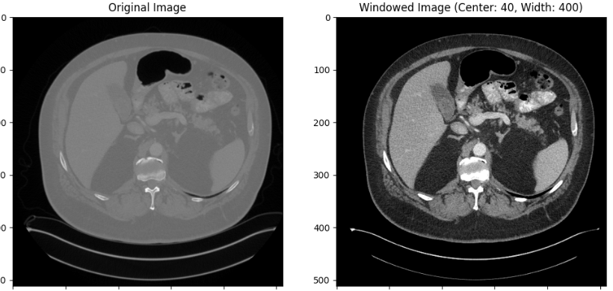
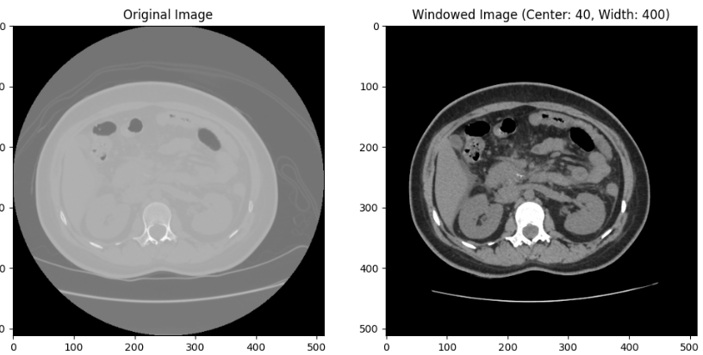
Data - Preprocessing
CT-82
(Normal)
Applying window level:
Window Center 40HU
Window Width 400HU
Image augmentation is done using rotation and translation
Chronic
Pancreatitis

Slide 9
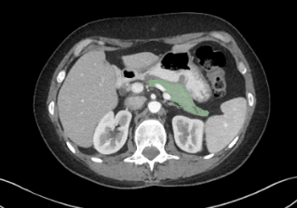
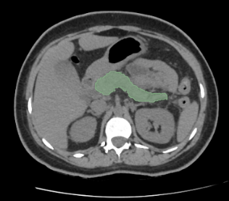
Data - Preprocessing
Final Dataset being fed as input to the model
CT-82
Chronic
Pancreatitis

Slide 10
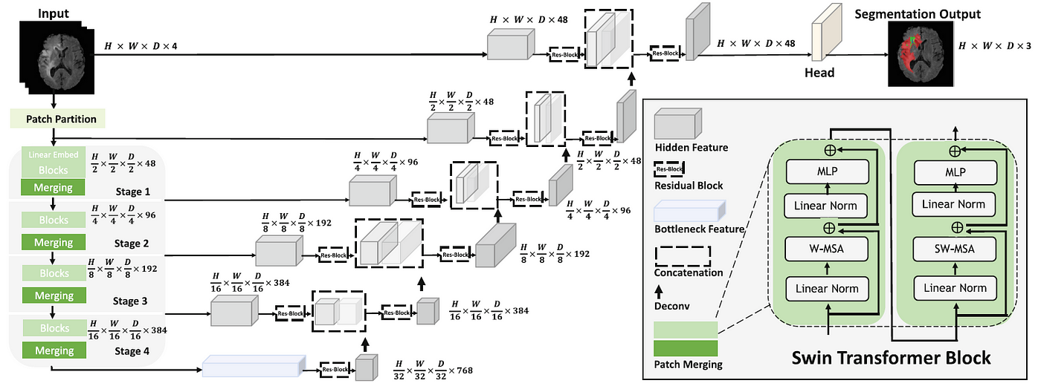
Model - SwinUNETR
Compared performance between MedSAM and SwinUNetR
Using only CT-82 dataset, Medsam showed 0.79 Dice score, SwinUNetR showed 0.851 Dice score
After choosing SwinUNetR, training with mixed dataset, it showed 0.7833 Dice score

Slide 11
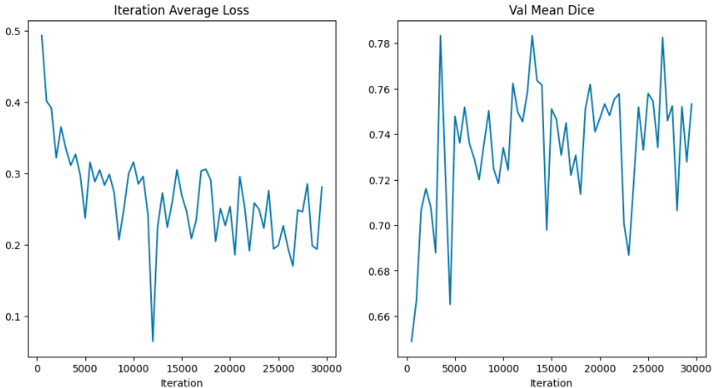
Model - SwinUNETR
Training Loss / Validation Dice score

Slide 12
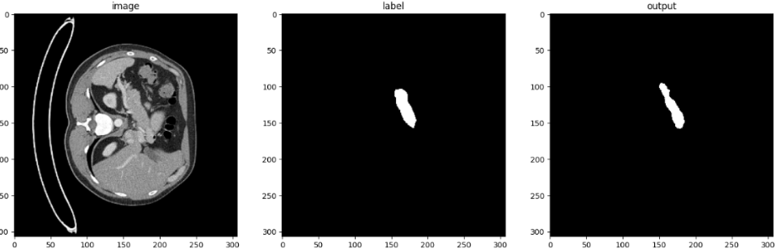
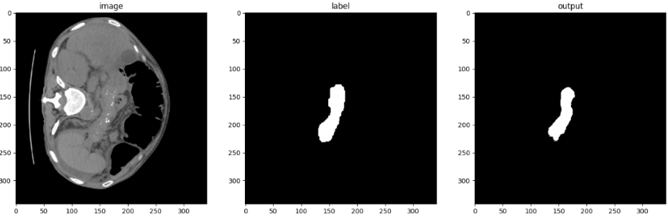
Model - SwinUNETR
0.7833
Dice Score
CT-82
Chronic
Pancreatitis

Slide 13
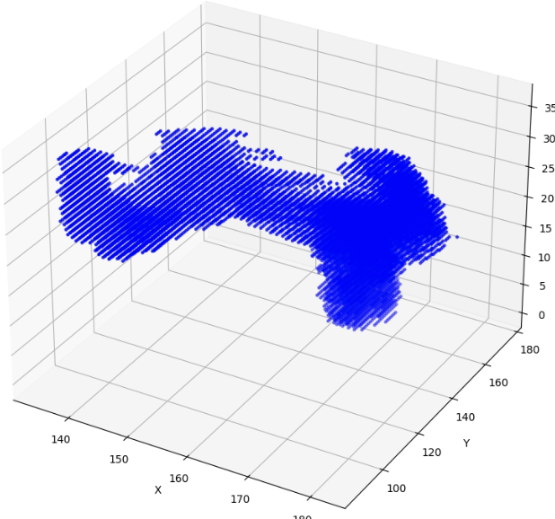
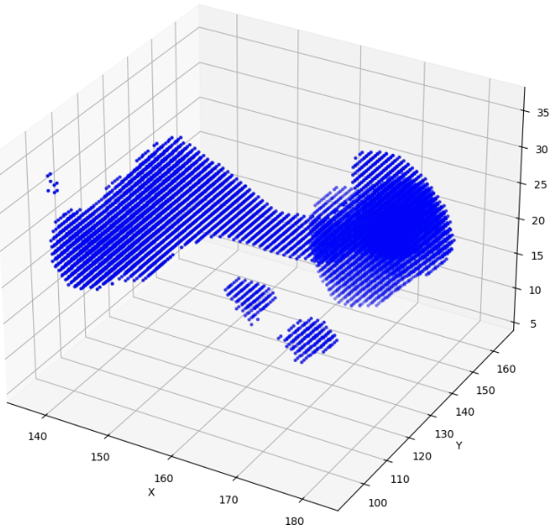
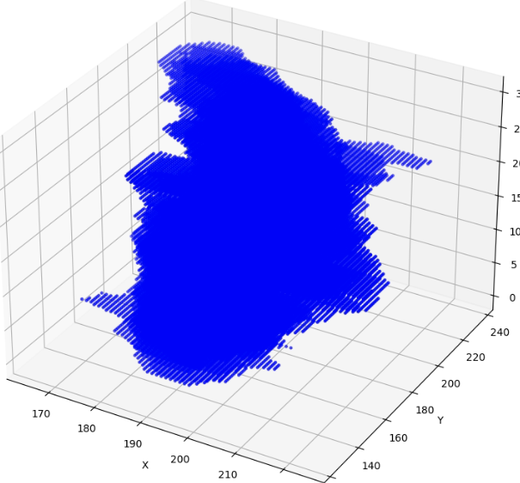
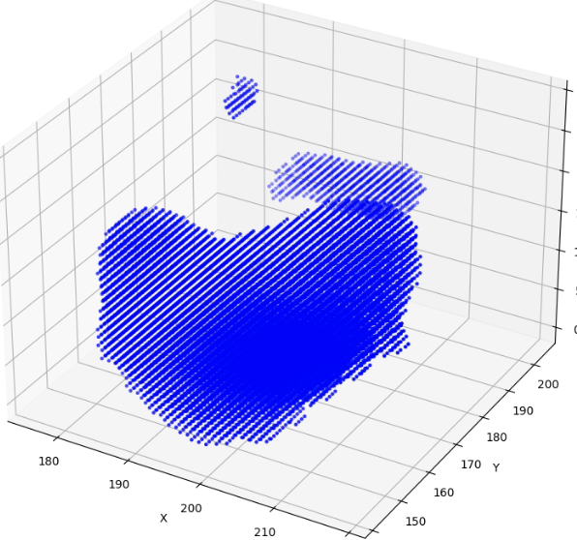
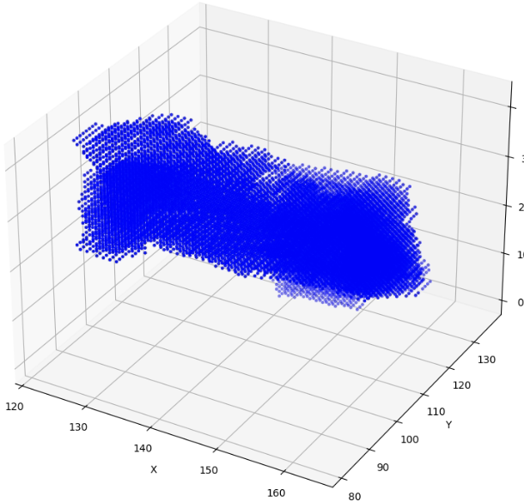
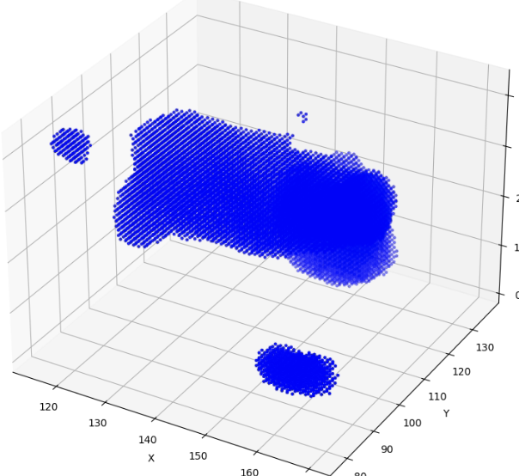
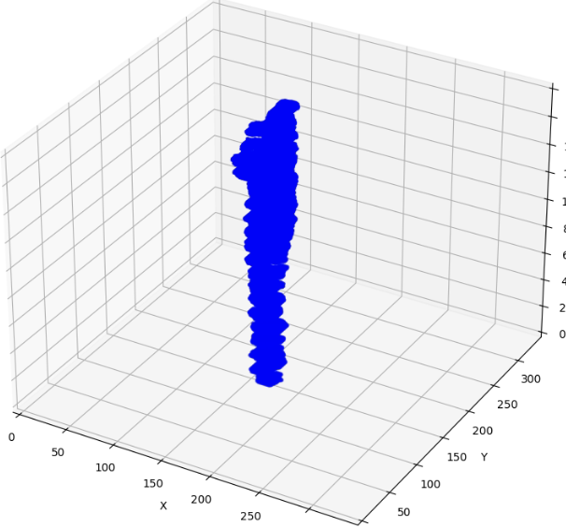
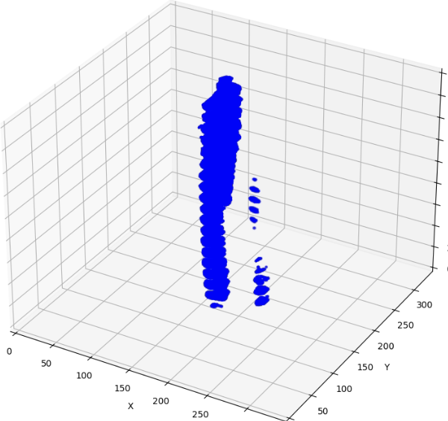
Model - SwinUNETR
CT-82 images
CP images
Label ←→ Predicted
Label ←→ Predicted

Slide 14
Postprocessing
Postprocessing Techniques
Connected Component Analysis
- Identify connected components
- Remove small components
Morphological Operations
To modify shape using
Erosion(Shrinking)
Dilation(Expanding)
Opening(Remove small regions)
Closing(Filling dark regions)
Effective in removing noise, enhancing
boundaries, filling gaps
Label ←→ Predicted

Slide 15
Summary
Collected and analyzed CT volume data from chronic pancreatitis patients (SRM Hospital)
Designed and implemented the full pipeline for pancreas segmentation and volumetric feature extraction
Performed preprocessing including window-level adjustment and normalization
Compared segmentation models (MedSAM vs. SwinUNetR); selected SwinUNetR based on superior Dice score (0.7833)
Postprocessed segmented volumes to extract complete 3D pancreas structures
Extracted radiomic features from the segmented pancreas, intended for disease symptom analysis and progression prediction

